Slide 1
The NBA MVP
UC Berkeley Data Analytic Bootcamp
By Billy Huang
https://github.com/QQrex/Predicting_NBA_MVP_by_the_Stats

Slide 2

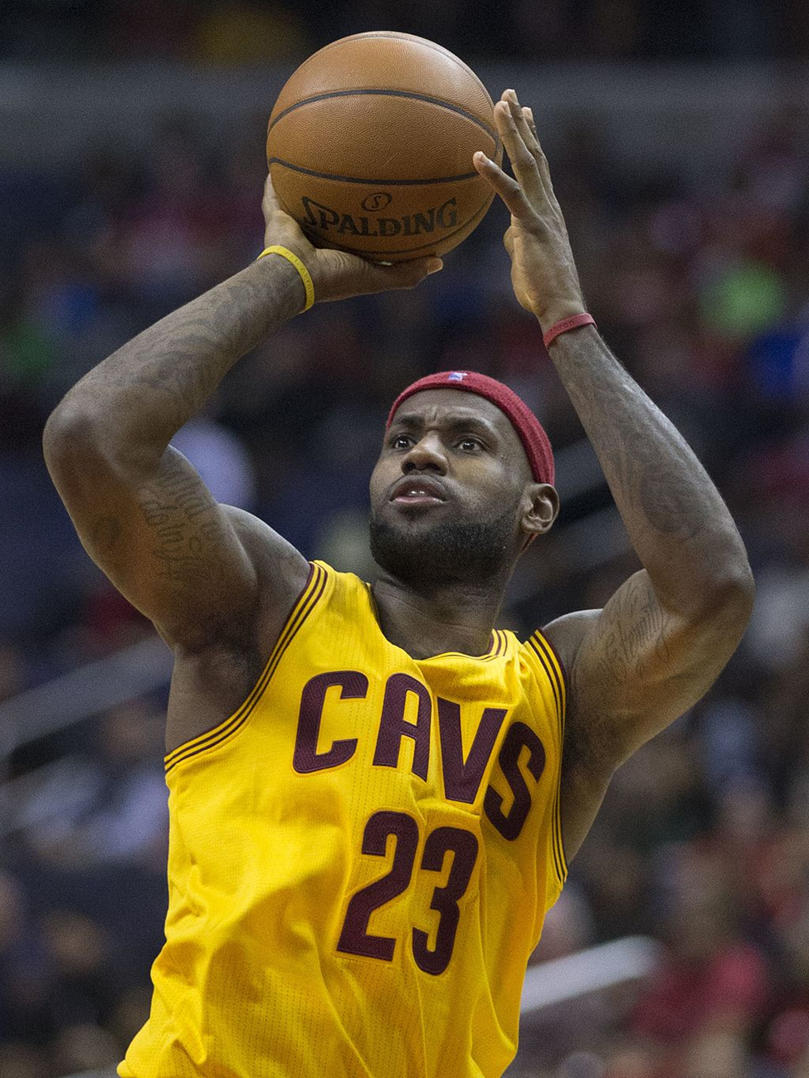
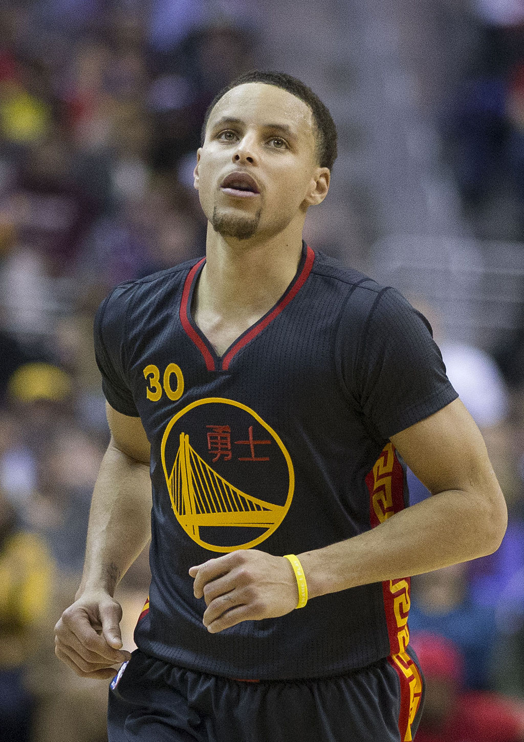
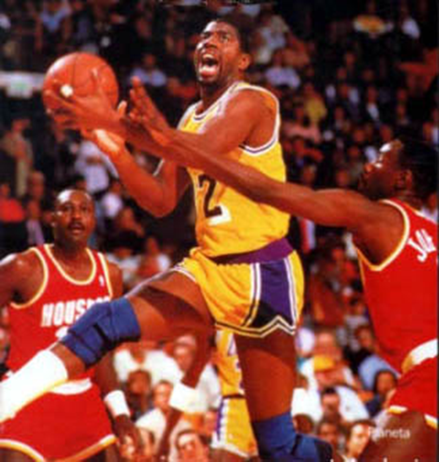
Who are these people?

Slide 3
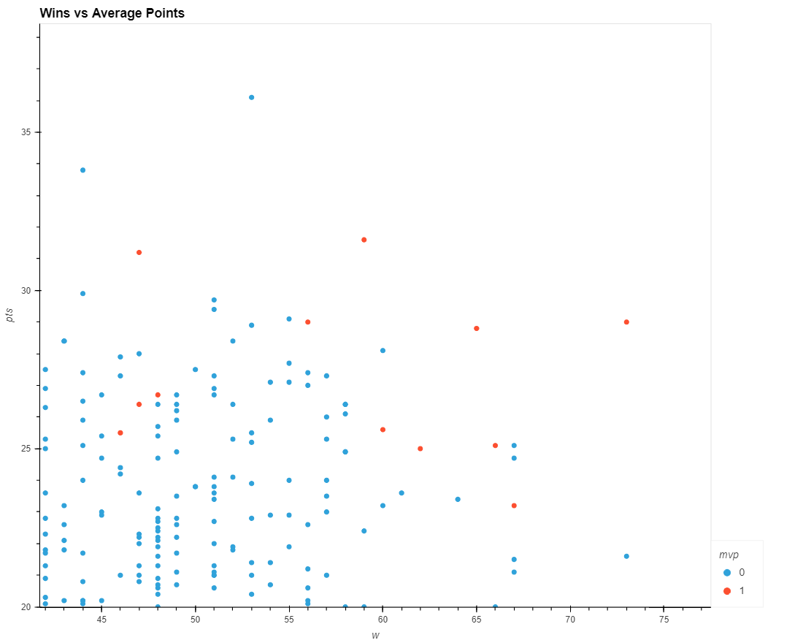
Who wins and scores the most?
Data from season 2010-present

Slide 4
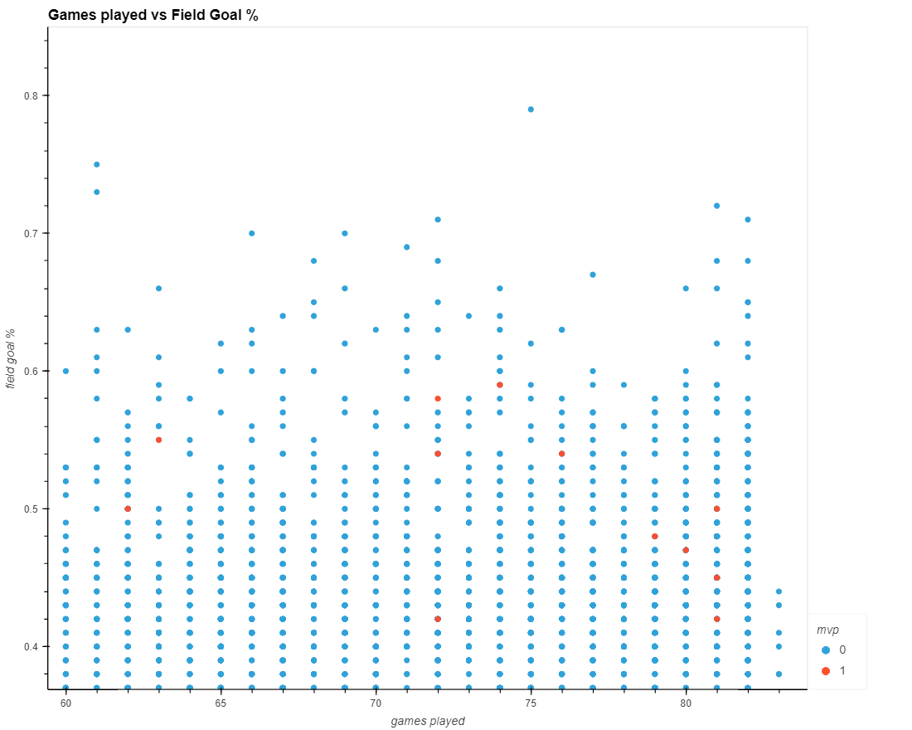
Efficiency?
Data from season 2010-present

Slide 5
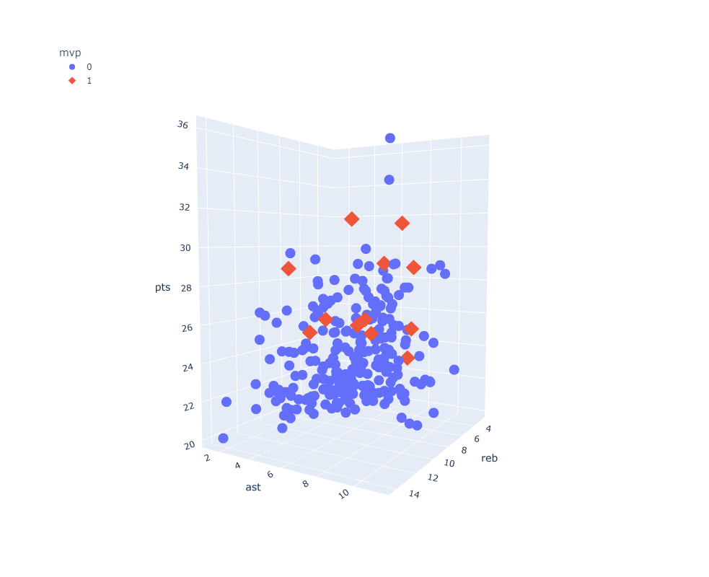
The Trinity
Points
Assists
Rebounds
Here you give a brief intro of the topic you want to talk about. For example, you can talk about Mercury
Data from season 2010-present

Slide 6
Machine Learning for the Assist

Slide 7
Our Data Timeline
1955
2022
2010

Slide 8
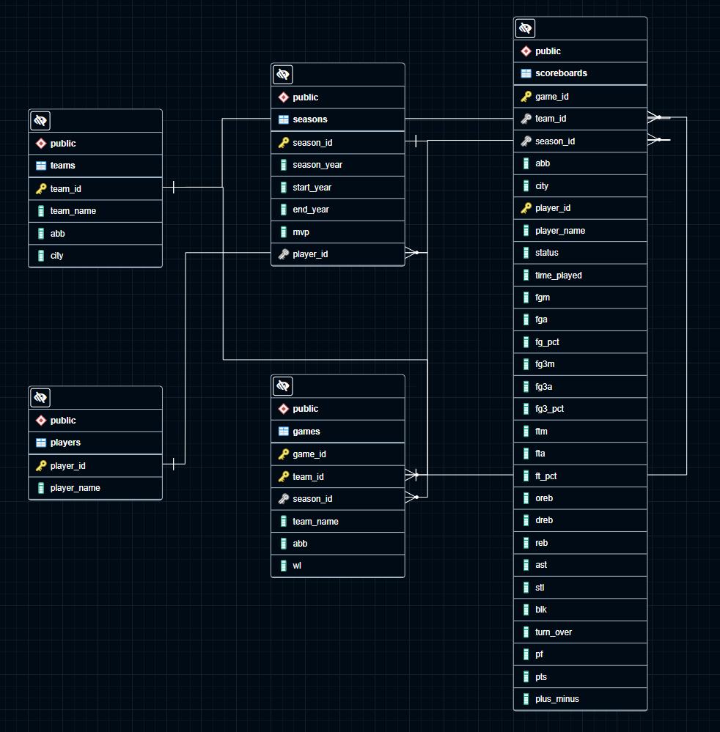
ERD

Slide 9
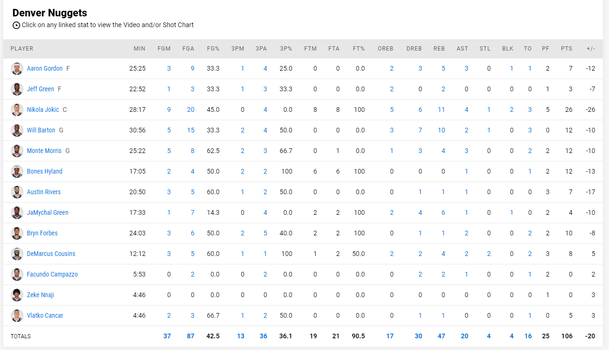
Box Score example

Slide 10
Workflow
Preprocessing
Juypter notebook
Database
Machine Learning
Postgres SQL database
SKlearn library

Slide 11
Preprocessing
01
03
02
04
Stats
Train, test, split
Average box score stats, games played, win, mvp label
Split our data into training, testing data.
Separate
Scale
Separate our features and target label
Scale data with sklearn.

Slide 12

Room
Hi, my name is Class Imbalance

Slide 13
Addressing Class Imbalance
Random Oversample
SMOTE
SMOTEEN

Slide 14
Machine Learning Models
Abbreviation | Models
LR | Logistic Regression
SVM | Support vector machine
DT | Decision Tree
RT | Random Forest
B | Gradient Boosting

Slide 15
RESULTS
ACCURACY SCORE : 0.99

Slide 16
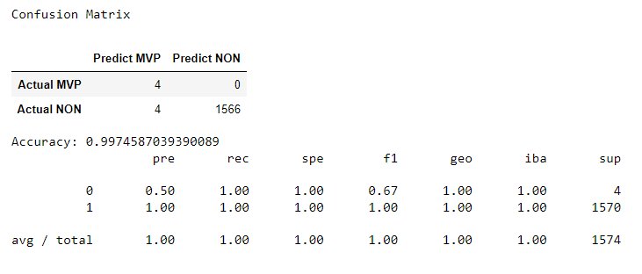
Logistic Regression
SMOTE
Precision: 0.50
Recall: 1.00
F1: 0.67

Slide 17
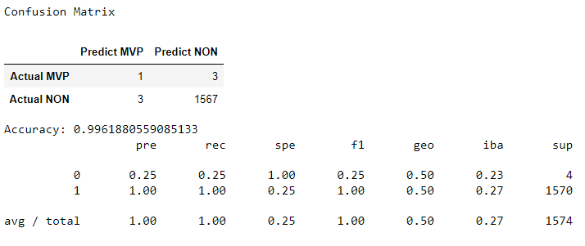
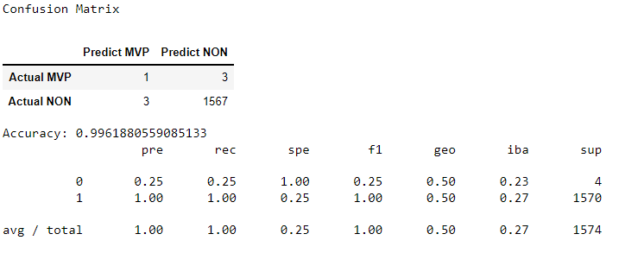
Support Vector Machine
Random Oversampling
Precision: 0.25
Recall: 0.25
F1: 0.25
SMOTE
Precision: 0.25
Recall: 0.25
F1: 0.25

Slide 18
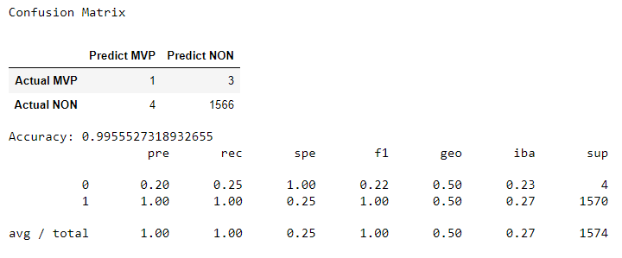
Decision Tree
Random Oversampling
Precision: 0.2
Recall: 0.25
F1: 0.22

Slide 19
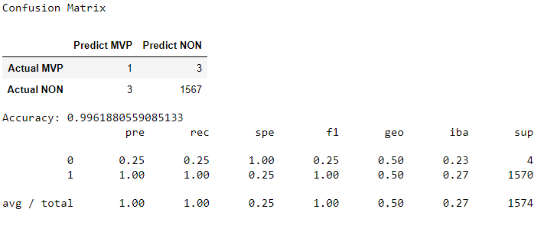
Random Forest
SMOTEEN
Precision: 0.25
Recall: 0.25
F1: 0.25

Slide 20

Gradient Boosted
SMOTEEN
Precision: 0.25
Recall: 0.25
F1: 0.25

Slide 21
Dashboard

Slide 22
Recommendations
More Data
New Features
Try different models
More data to train and test our models
Find new metrics to train our model
Deep learning

Slide 23
Fin

Slide 24
Resources and Tools
Resources
Tools
NBA.com
https://github.com/swar/nba_api
https://en.wikipedia.org/wiki/NBA_Most_Valuable_Player_Award
Postgres
Jupyter Notebook
Pandas Library
Sklearn Library
Matplotlib Library
Hvplot Library
Visual Studio Code

